Slide 1
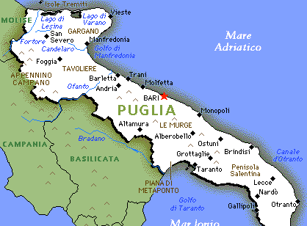

Slide 2
Cisternino has got a lot of customs and traditions which are typical of many places in Apulia.

Slide 3
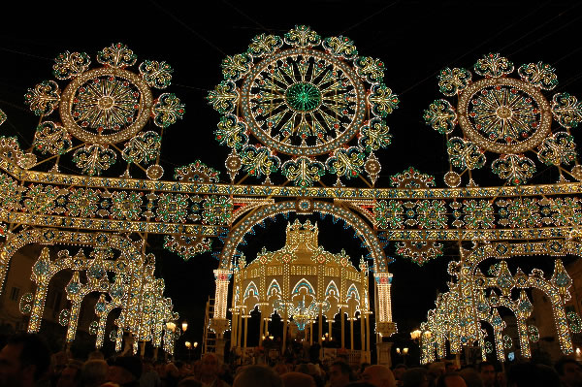
The most common are the patron saints’ , the countryside and the music festivals. Many of these celebrations happen in summer when the weather is fine and one of the main features is that the town is floodlit.

Slide 4
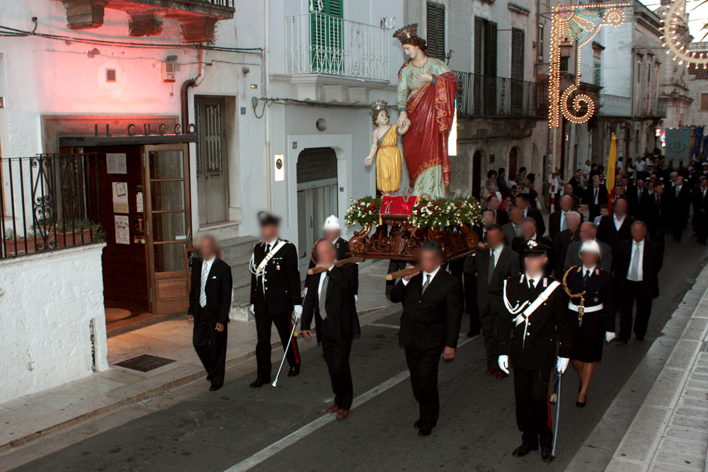
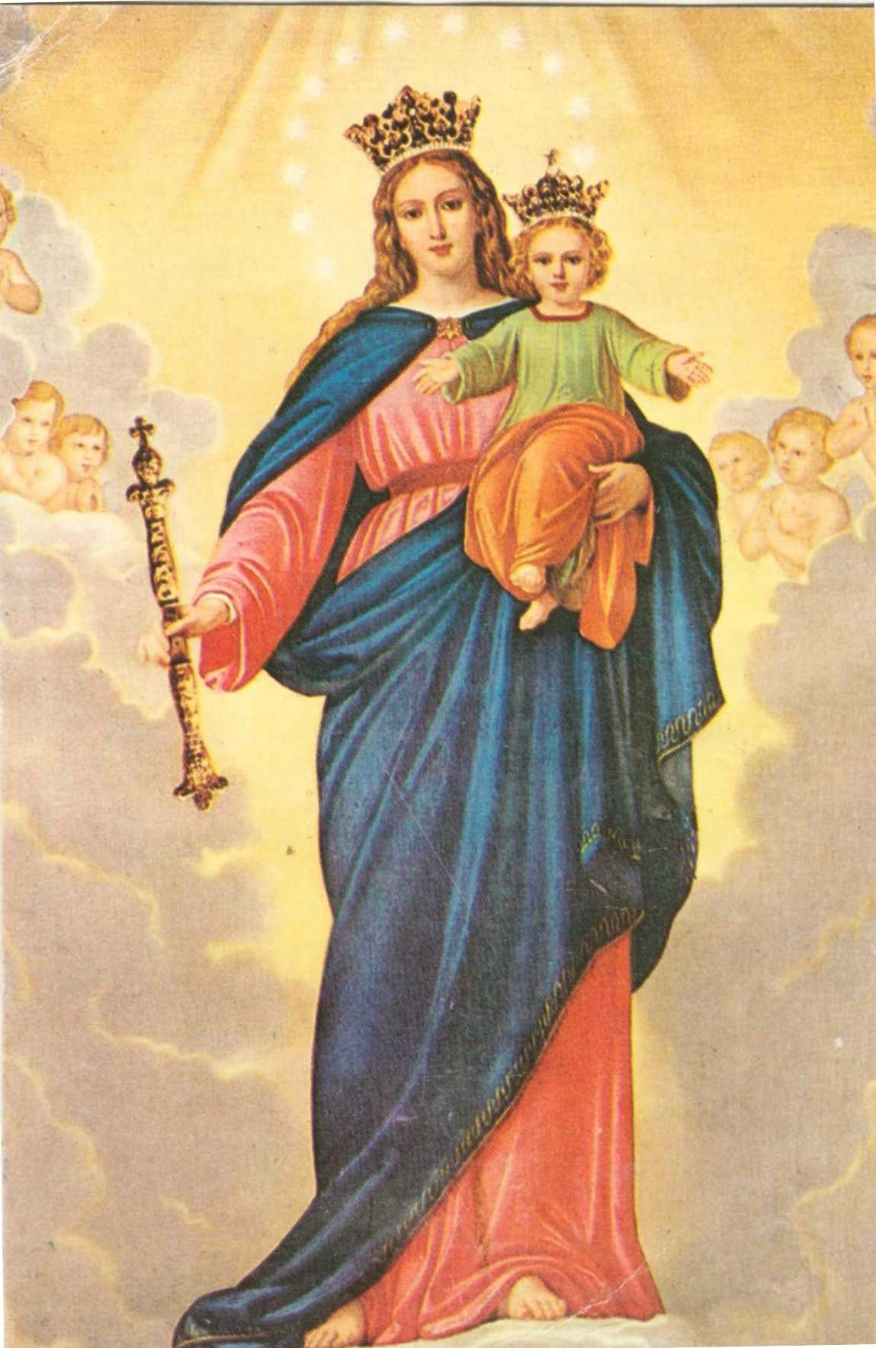
Mary Help of Christians
Festival held on the 24th of May
St. Quirico and Giulitta
Patron saints of Cisternino
Festival held in the first week of August

Slide 5
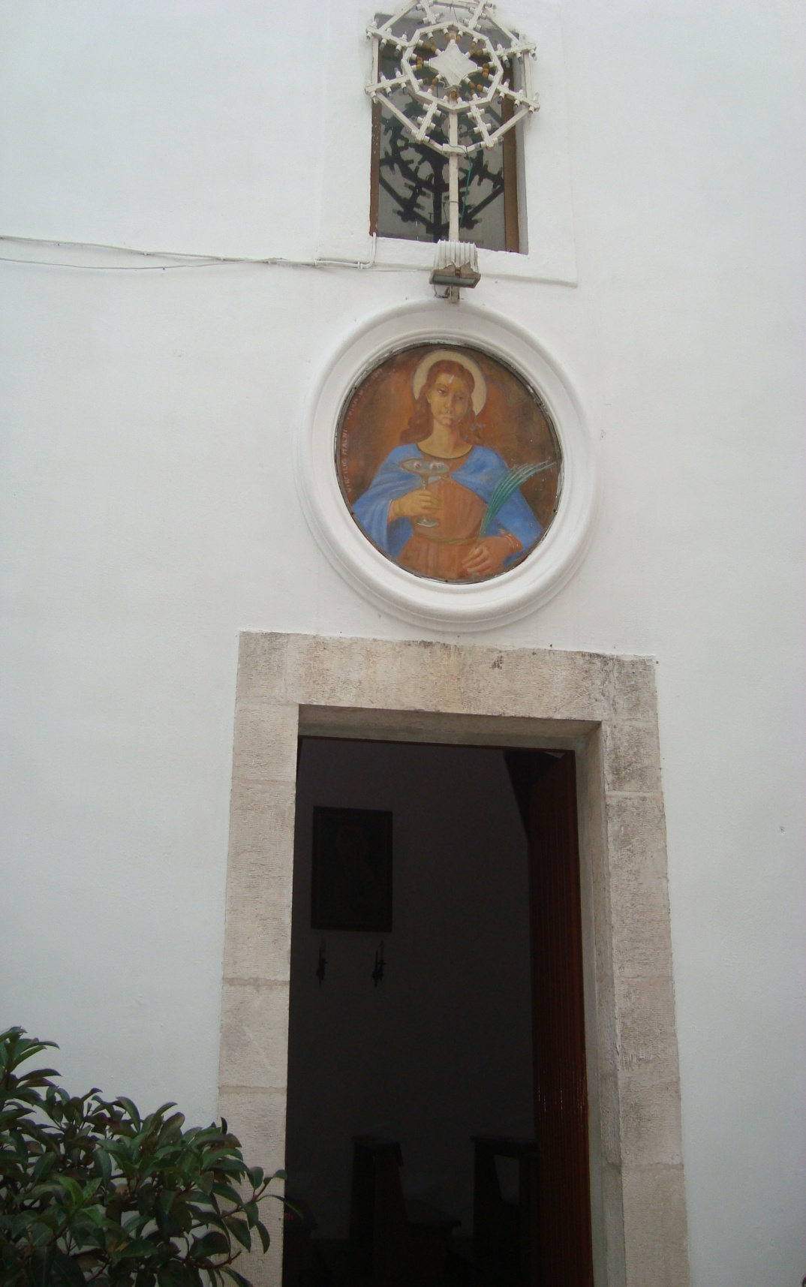
Saint Lucy's day: December the 13th
Celebrations: In the town centre:
A religious procession and concerts
Food and merchandise stalls
In the countryside :
Big bonfire
Eating roasted potatoes on the charcoal fire

Slide 6
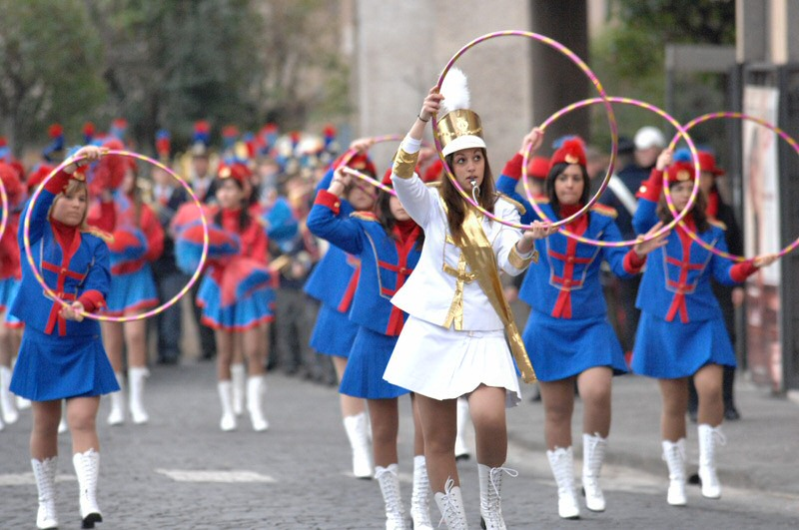
International festival of musical bands
Held in July

Slide 7
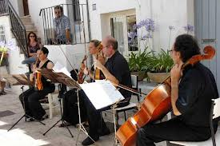
Festival of different kinds of music

Slide 8
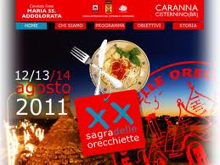
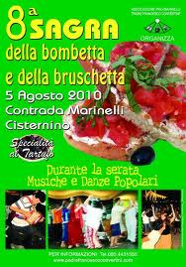
Countryside festivals to taste some of our typical dishes

Slide 9
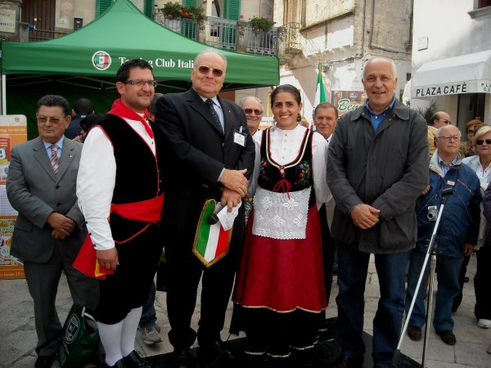
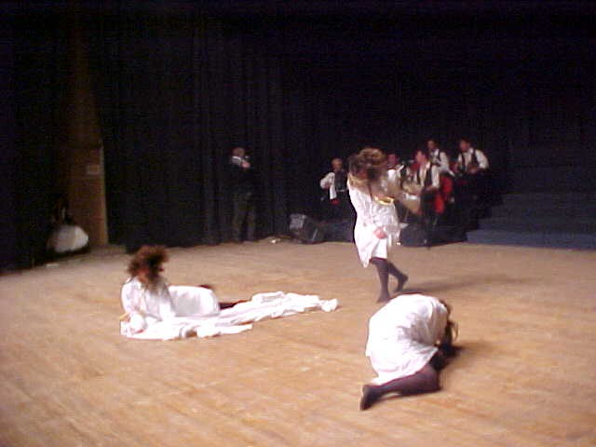
We can’t forget the old folk dances
And the “pizzica” which is the most famous Apulian dance

Slide 10
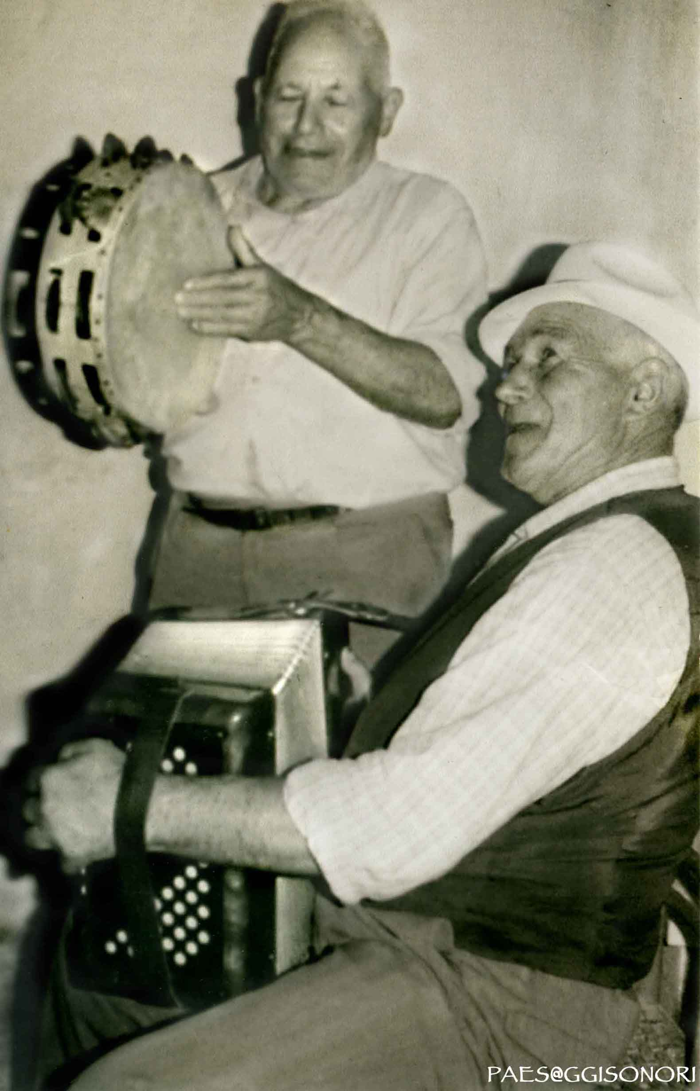
Pizzica
According to the tradition the people who are dancing look like they’ ve been bitten by a poisonous spider which makes them never stop dancing.
The instruments used to play this kind of music are the accordion and the “tamburrello” (a small handy drum)

Slide 11
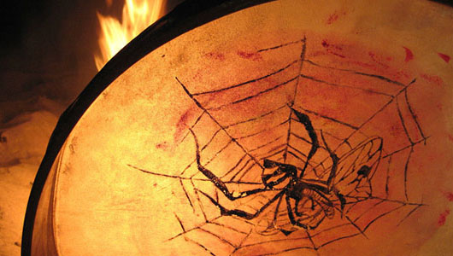

Slide 12
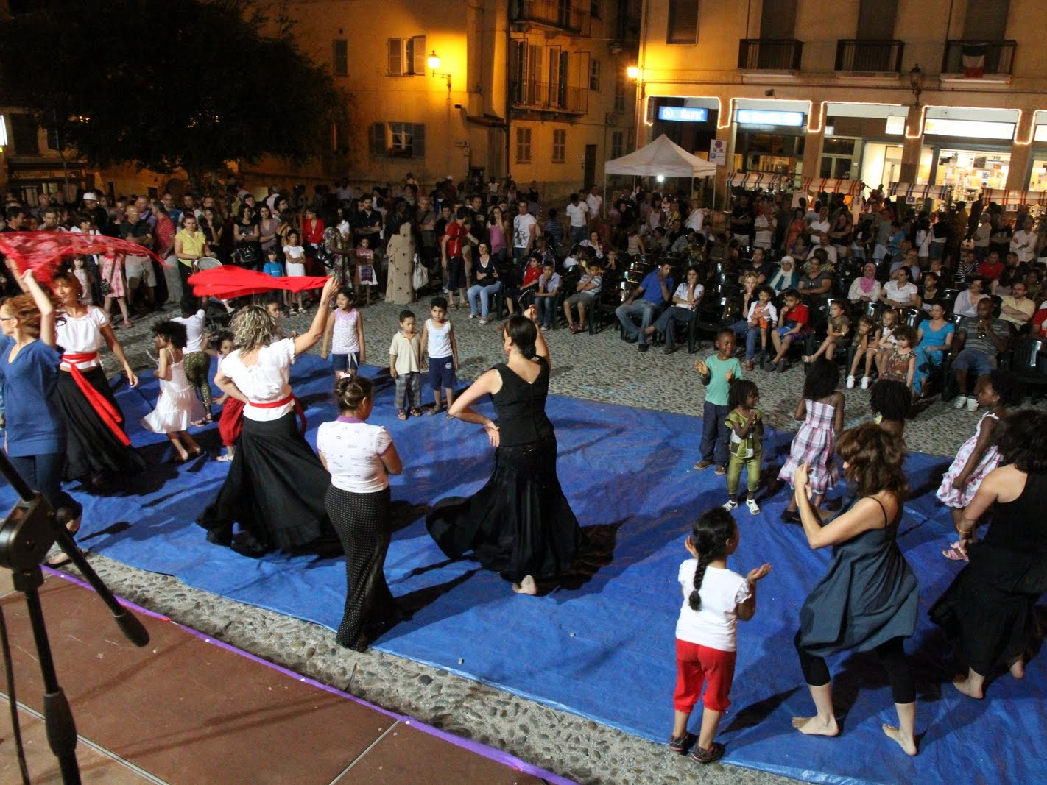

Slide 13
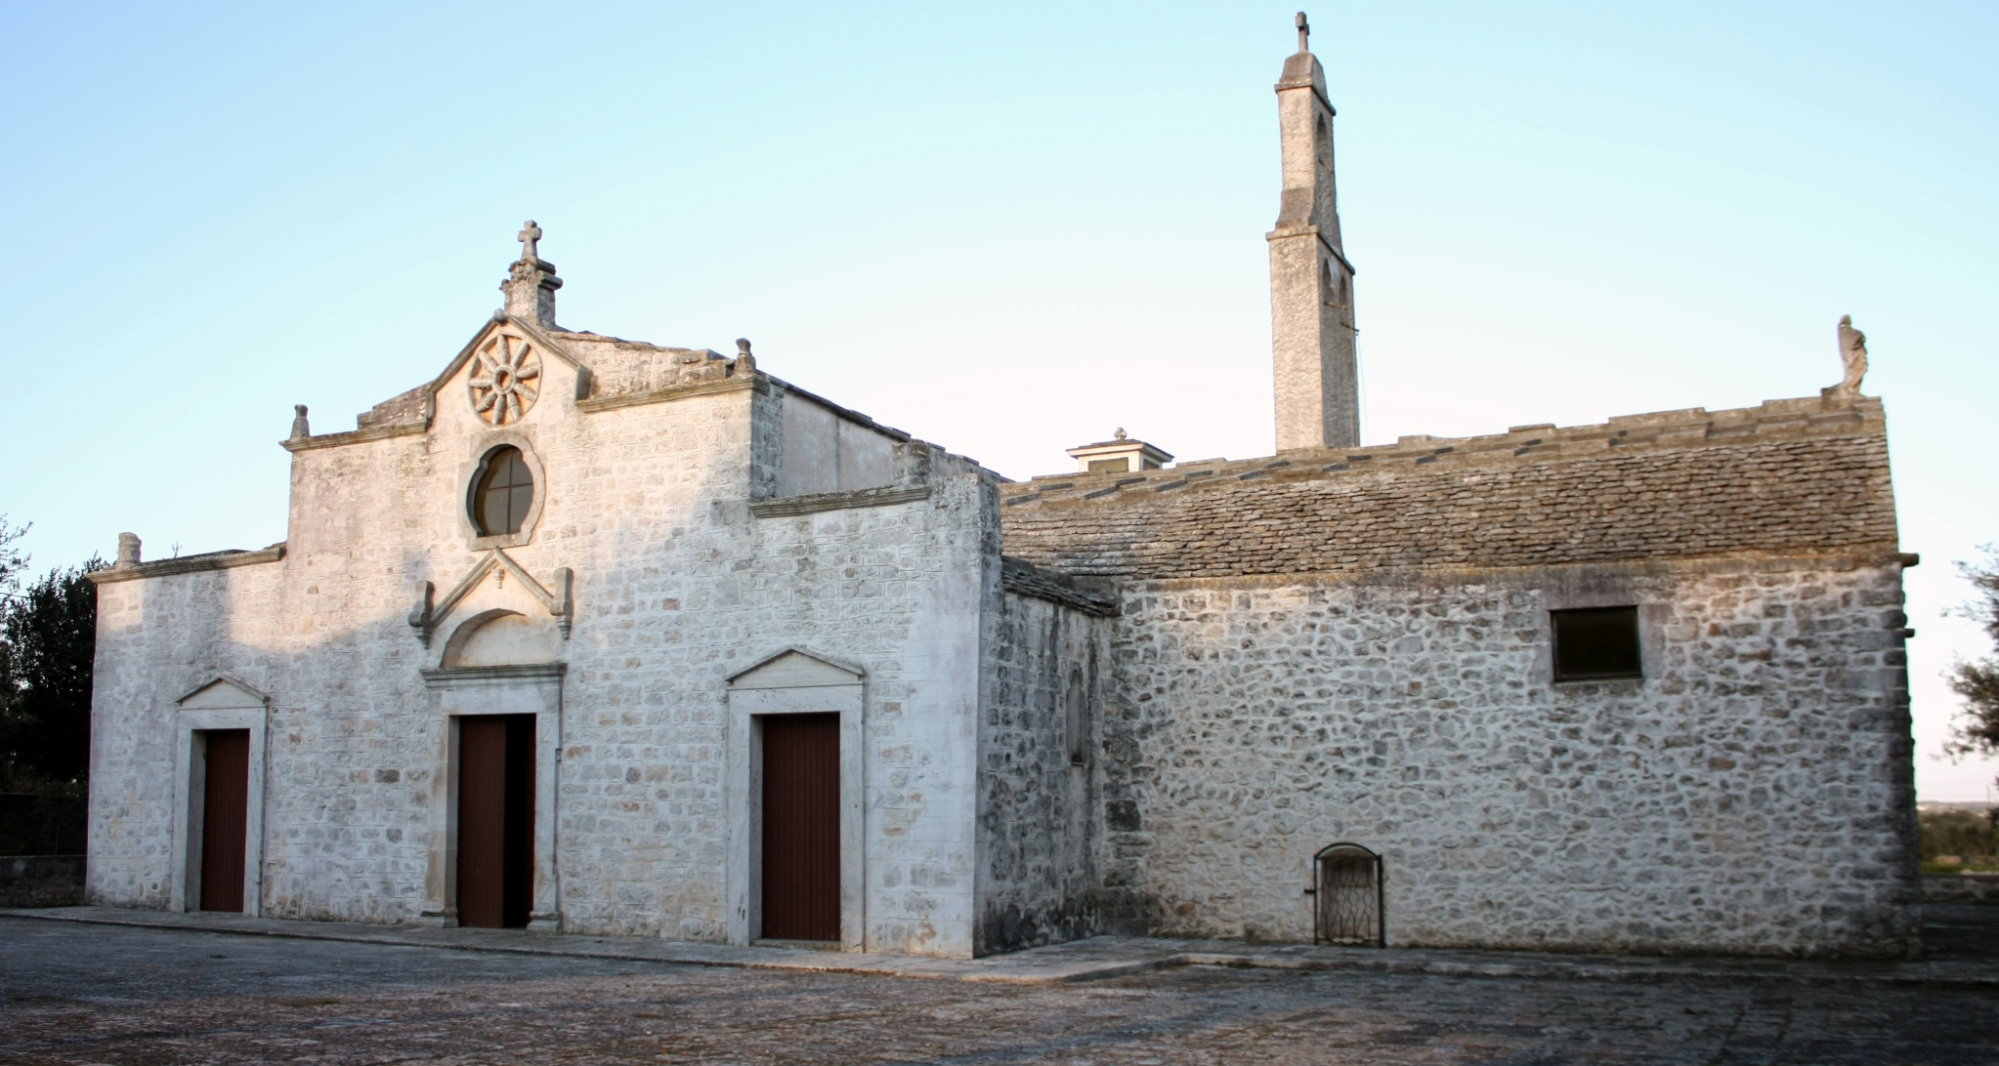
On Easter Monday there’s the tradition to go to a Sanctuary: “the Madonna of Ibernia” to propitiate fertility to young brides. In that occasion they take a special cake to be blessed and later eaten…

Slide 14
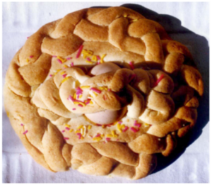
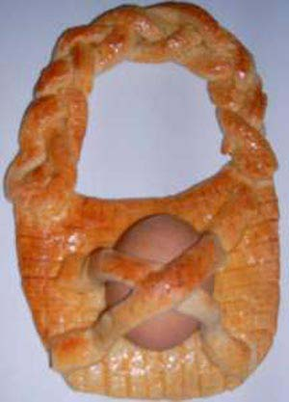
"u churrüchele"
It is shaped like a purse with two boiled eggs for the kids, and like a doll with a boiled egg for girls.

Slide 15
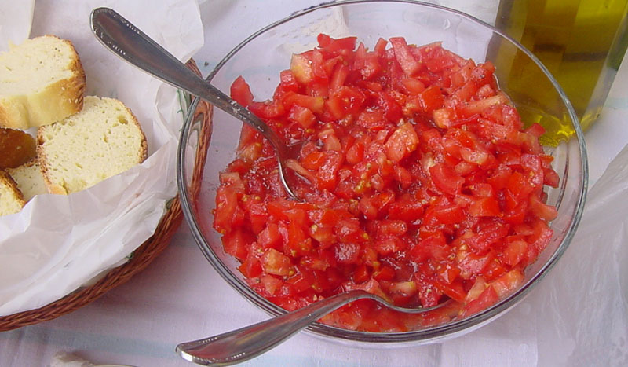
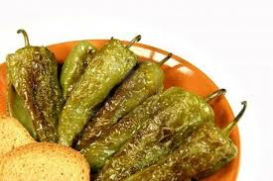
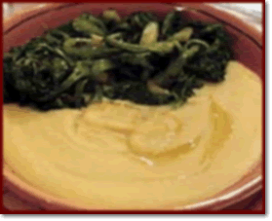
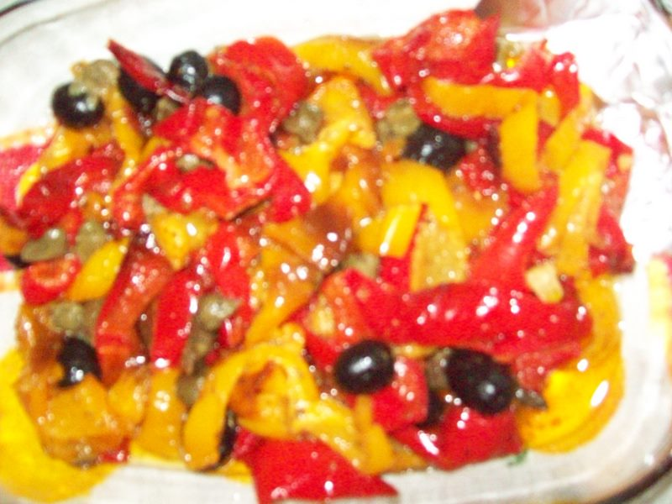
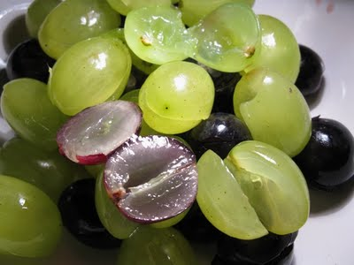
Other traditional
dishes
Tomato salad
Green peppers
Broad bean purée
with various side dishes
Grapes
Fried yellow peppers and tomatoes

Slide 16
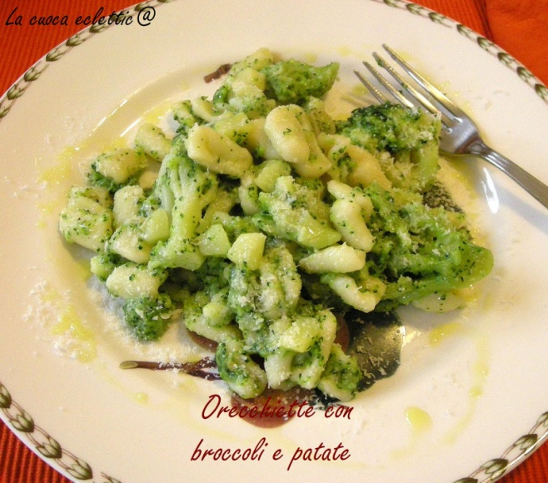
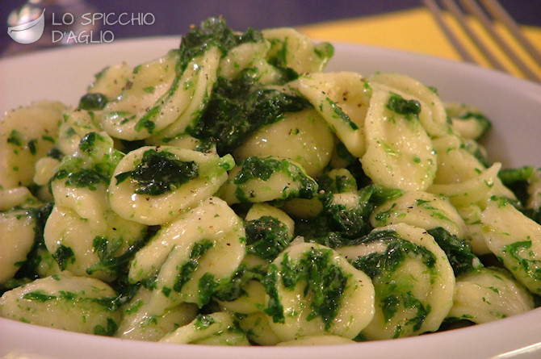
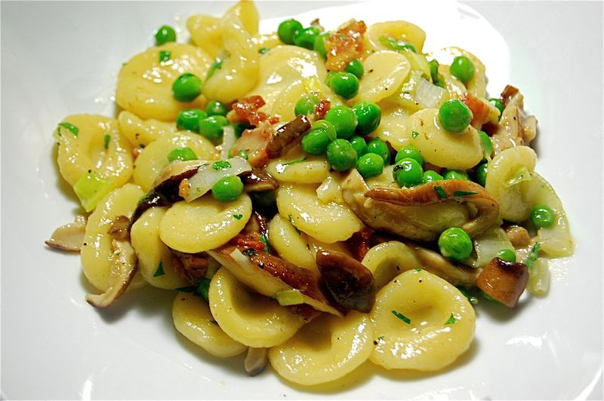
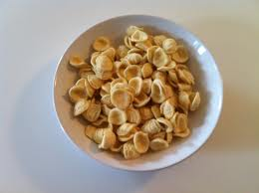
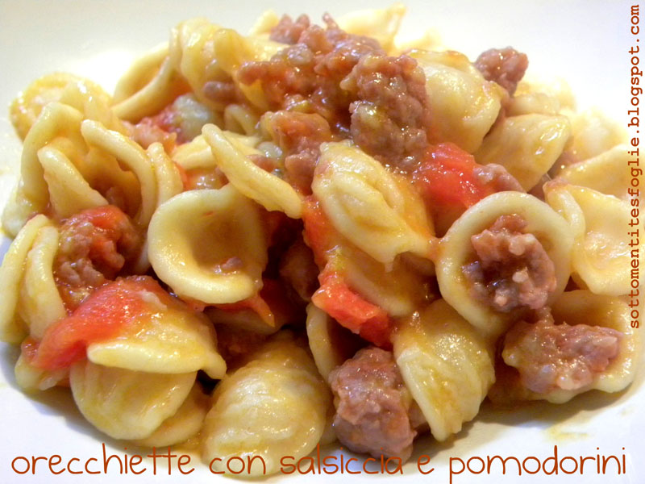
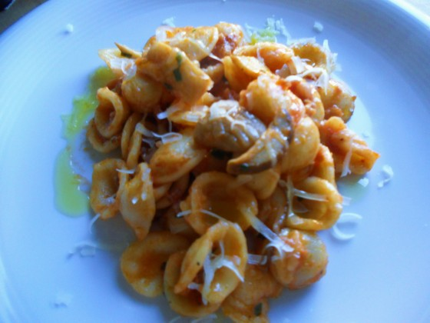
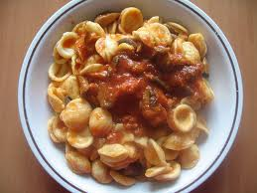
seasoned with various sauces and vegetables
Orecchiette

Slide 17
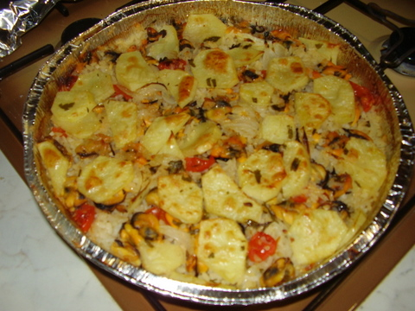
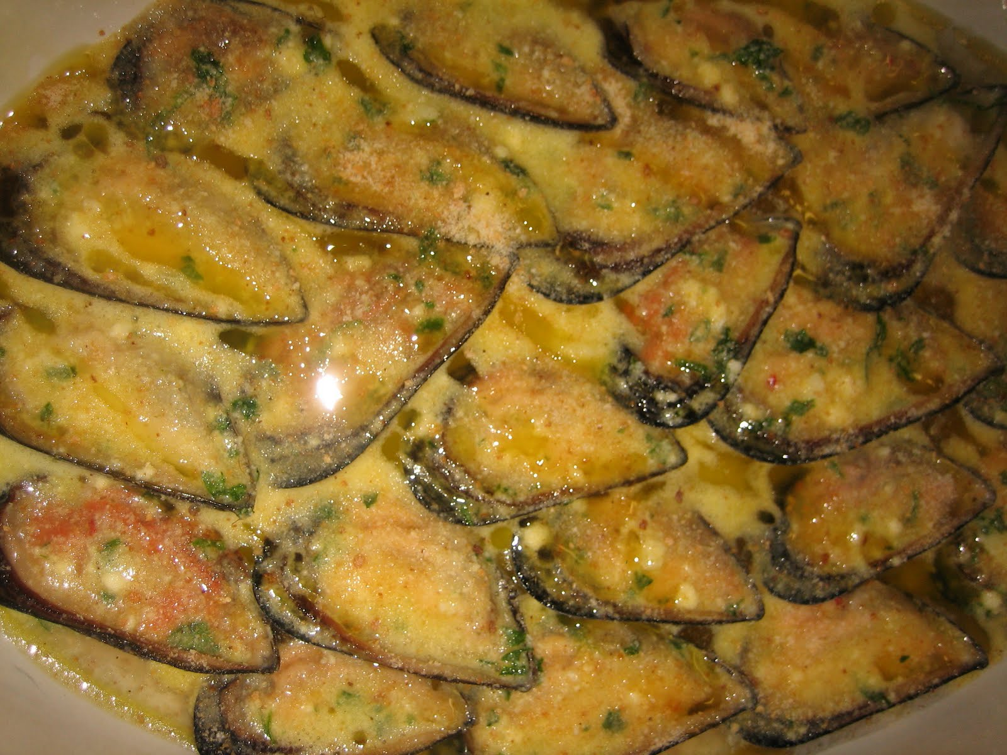
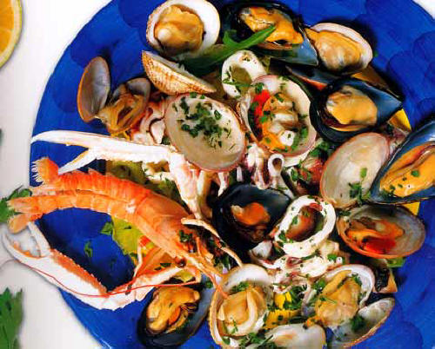
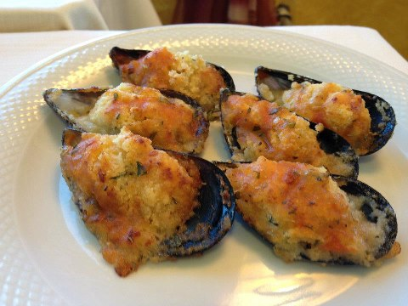
rice, potatoes and mussels
mussels
Stuffed mussels
Row mussels and row seafood

Slide 18
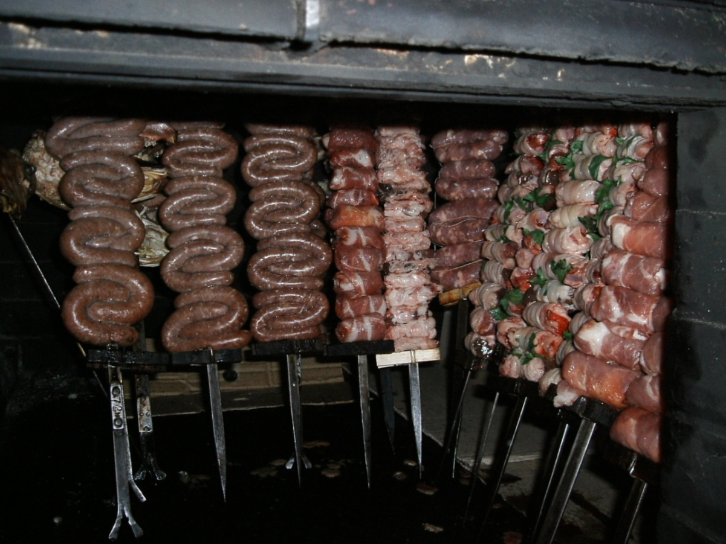
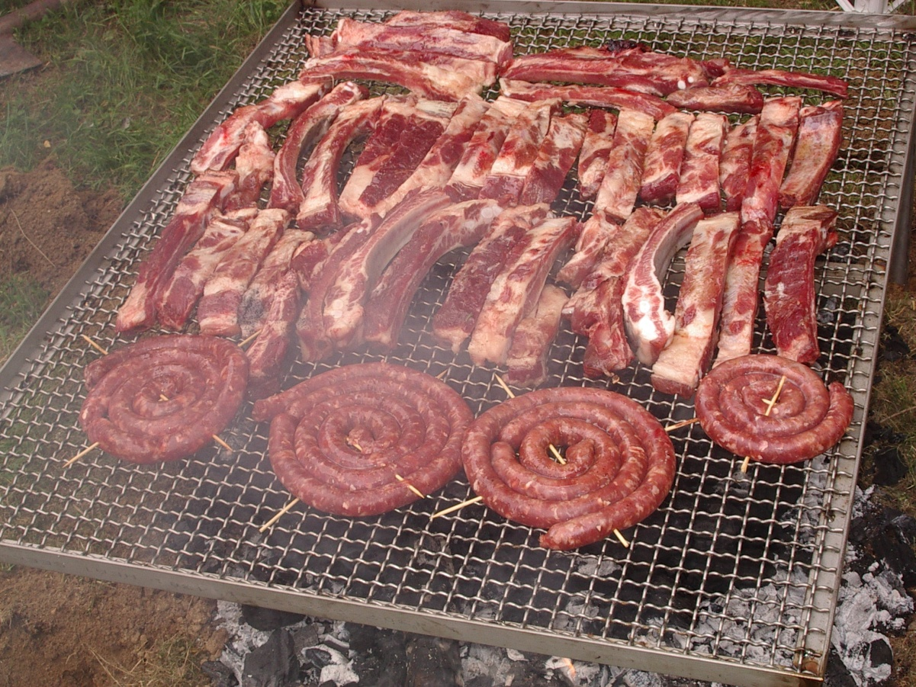
Roasted meat

Slide 19
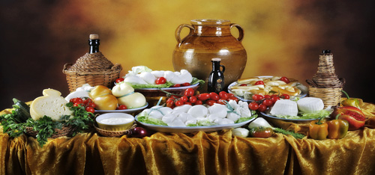
Dairy products

Slide 20
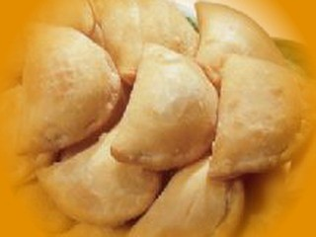
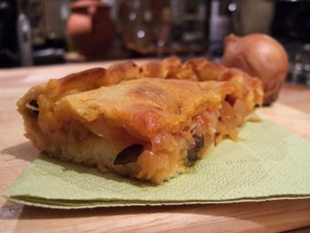
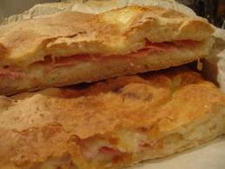
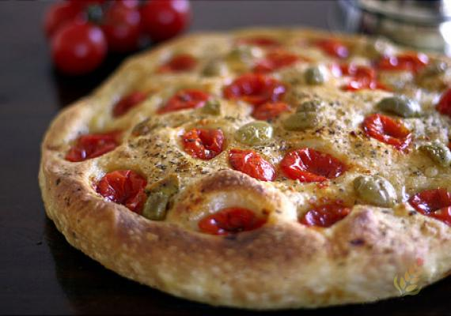
Fried pazerotti
Focaccia with onions
Focaccia with ham
Focaccia with tomatoes and olives

Slide 21
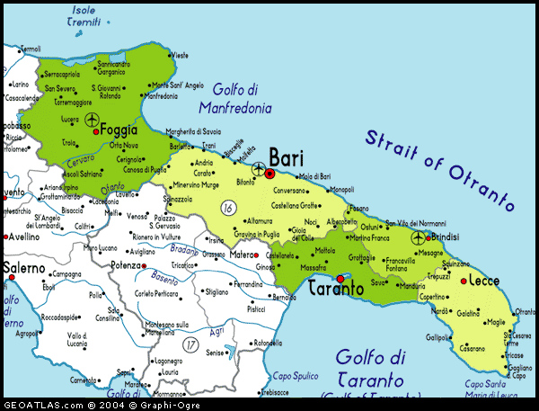
Enjoy and taste our region

