Slide 1
Democratic values ​​in Sweden
Notes:
These are some of the values we think are very important to take care of and protect..

Slide 2
Demokracy
Since 1921 Sweden has been a democratic country.
It began when both men and women got the right to vote.
In Sweden we have: gender equality, freedom to express / freedom of the press, cultural diversity and religious freedom.

Slide 3
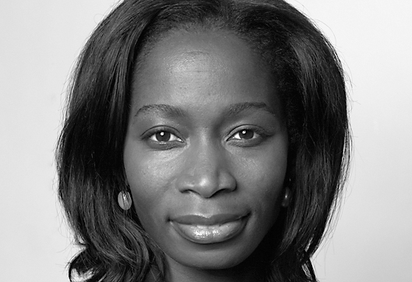
Equality between sexes
Curriculum
Discriminationlaw
Sweden’s equality minister
Notes:
The goal of equality policy is a tolerant and humane society of great diversity and where human rights are respected. The Government's work aims to Sweden to be aware that discrimination exists, that it is unacceptable and that we are aware of what it is that makes people become xenophobic, racist or hostile to such as homosexuality.
We have a discrimination law since January 1st 2009, which states that it is forbidden to discriminate
- Gender identity or expression - Ethnicity - Religion or belief - disability - Sexual orientation - Age
This law applies everywhere in society. While the law was introduced, we also got a discrimination man to ensure compliance with the Act and provides grants to organizations working against discrimination, racism and homophobia.

Slide 4
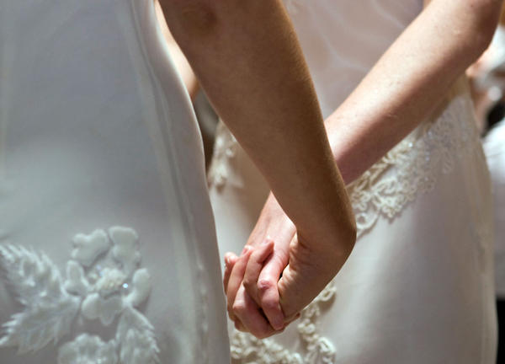
Notes:
Since 2009 same sex-marrige are allowed.

Slide 5
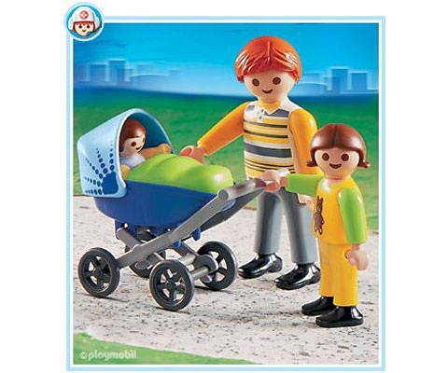
Notes:
Equality in Sweden is about giving women and men the same opportunities and the power to influence their lives. Both women and men need to have the same opportunities and the right to care for their children. The equality bonus is about making it easier to share the parental leave equally (leave Equality after a baby). If you share the parental leave equally you’ll get 13 500 SEK (about 130 Euro). It is about trying to educate and deal with violence and abuse against women. For 2013 and 2014 allocated approximately SEK 239 million per year for specific policy actions.

Slide 6
The freedom of speech
TV, radio, newspapers
Base law’s
Notes:
The freedom of speech gives us the opportunity to write, say, think and print and post almost whatever you want in radio or television. Freedom of expression is that everything can be said and written. But there are some expections, for example, you’re not allowed to write statements that can harm others.

Slide 7
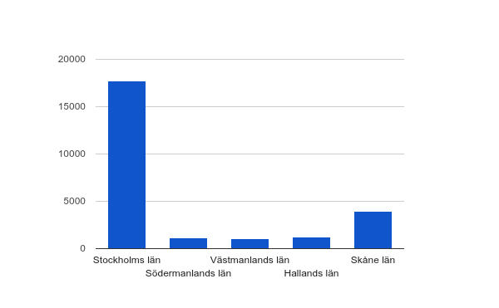
Cultural Diversity
2012
Notes:
During the first six mounth 2012, 45 270 people has imigrated to Sweden. At the moment many of them com from Syria and Afghanistan.
The curiculim says that school have to offer the children from these countries the same education as if they were born in Sweden.
The imigration to Sweden makes Sweden very rich on all kind of cultures. This is an access, we get to know all kind of friends at school from all over the world. For companies this is also an access and it makes it easier to make business with the rest of the world.

Slide 8
Religion freedom
Diffrent religions
Faith
Notes:
In school, we learn about all of our great world religions, Christianity, Islam, Judaism, Hinduism and Buddhism. We learn about their origins, sacred texts, sacred sites, propagation and message and learn. This is to enable us to understand and respect people with a different religion, one's own and to be able to see the similarities between them not only differences.

Slide 9
Is Sweden perfect? No…
Because…
Notes:
The goal of the government's efforts is to promote a vibrant democracy where every citizen feels that he / she has influence and can influence the decisions that govern their everyday life. Another goal is to work for human rights.

