Slide 1
Literature

Slide 2
The beginning of literature in Greece
Poetry was a part of Greek literature ever since the ancient Greece.
Some famous poets were Aristofanes, Eshilos, Euripides, Sofokles, Sapfw and Homer.
Many people still read ancient Greek literature and students have school lessons based on it.

Slide 3
Greek literature all around the world
Many Greek poets are known worldwide, some of them are also awarded with the Nobel prize.

Slide 4
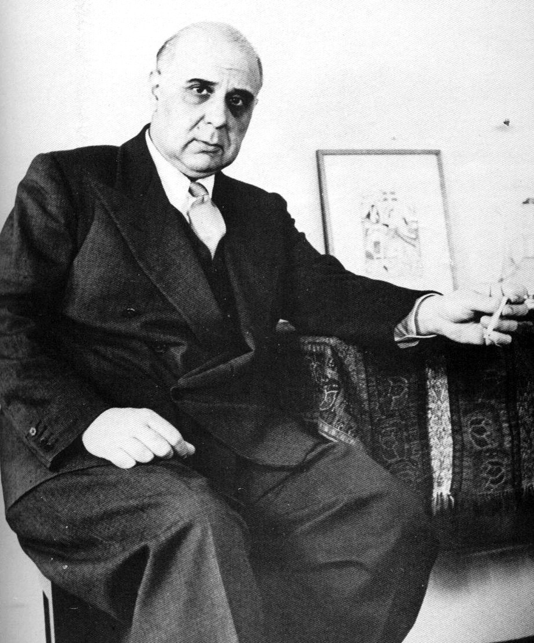
George Seferis
He was born in 29/2/1900 and died in 20/9/1971
“...and the man ended up a lifeless sack…”

Slide 5
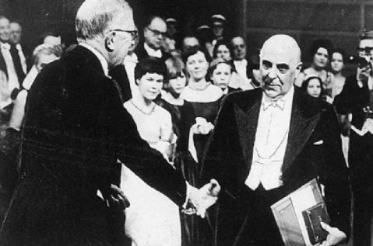

Slide 6
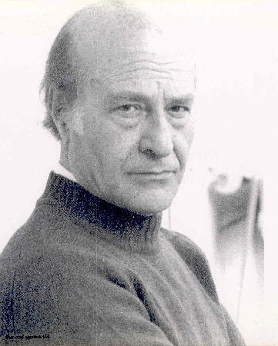
Odysseus Elytis
He was born in 2/11/1911 and died in 18/3/1996
“ ... fishing is the sea where the smell of fish sparkles so do not look in vain ...”

Slide 7
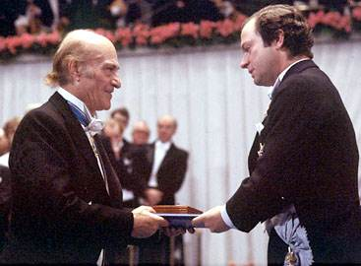

Slide 8
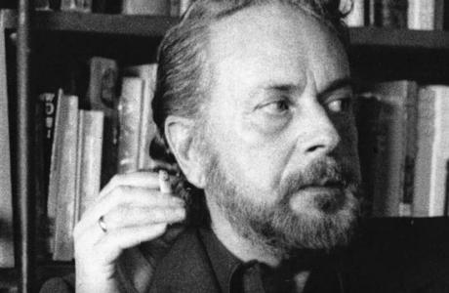
John Ritsos
He was born in 1/5/1909 and died in 11/11/1990
“ ... many verses are like doors, closed doors… like dilapidated houses ...”

Slide 9
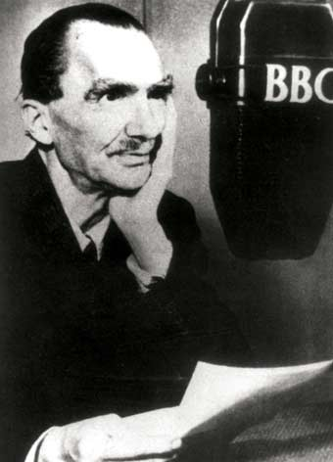
Nickos Kazantzakis
He was born in 18/2/1883 and died in 26/10/1957
“ ... a lightning is our life, but we still anticipate ...”

Slide 10
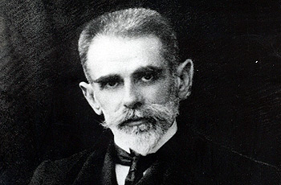
Kostis Palamas
He was born in 13/1/1859 and died in 27/2/1943
“... the greatness of nations is not measured by the acre, but with the heart and blood ...”

Slide 11
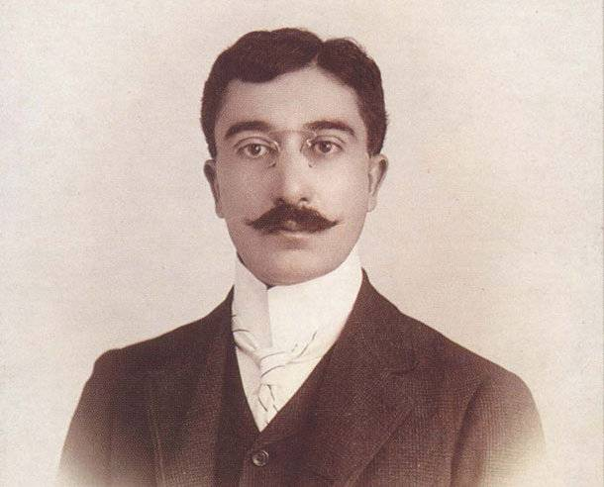
Konstantinos Kavafis
He was born in 1863 and died in 1933
“... the married man lives like a dog and dies like a human.
The unmarried lives like a human and dies like a dog ...”

Slide 12
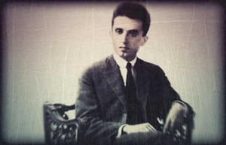
Kostas Kariotakis
He was born in 30/10/1896 and died in 1928.
“... unruly body parts, transparent clothes, slimy mouths, hypocritical, unsuspecting creatures, and therefore privileged…”

Slide 13
Students prefer Greek or foreign literature?!

Slide 14
On the other hand. . .

Slide 15
Another point of view...

Slide 16
The authors that are mostly read in Greece are:
Alki Zei, Jorz Sarri, Menelaus Lountemis, Konstantinos Kavafis, Evgenios Trivizas, Papadiamantis etc.
And the ones we study at school are:Alki Zei, Papadiamantis, Kavafis, Ritsos, Kariotakis, Dido Sotiriou, Antoine De Saint Exuperi, Kazantzakis, Jorz Sarri etc.

Slide 17
Another study about literature…

Slide 18
Xenia Doulka
Fenia Koutsoumpelia
Dorita Metallinou

