Slide 1
Greek National Days

Slide 2
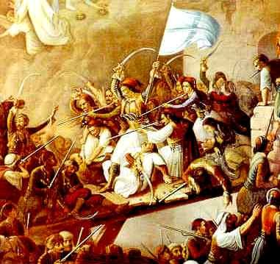
March 25th
March 25th is both a national and a religious holiday for the whole country.
The Byzantine Empire fell to the Turks in 1453 and the Greeks remained under the Ottoman rule for nearly 400 years. During this time their language, their religion and their sense of identity remained strong.
On March 25, 1821 the bishop “Paleon Patron Germanos” raised the Greek flag at the Monastery of Agia Lavra in peloponissos and one more revolution started against the Turks. The people of Greece shouted "Freedom or Death" and they fought the War of Independence for 9 years (1821-1829) until a small part of modern Greece was finally liberated and was declared an independent nation. After the revolutions a big amount of areas was under the Greek rule.

Slide 3
October 28th
“OHI”(NO) Day on October 28th 1940, commemorates the anniversary when former military general and Prime Minister Ioannis Metaxas said, “No” to an ultimatum made by the Italian Prime minister Benito Mussolini to allow Italian forces to occupy strategic locations in Greece or otherwise would face war.
On the morning of October 28, the Greek population took to the streets, irrespectively of political affiliation, shouting 'ohi'. Since 1942, it has been celebrated as Ohi Day.

Slide 4
Anniversary Those days were commemorated by the Greek communities around the world yearly. They became a public holiday in Greece and Cyprus. The events of 1821 and 1940 are commemorated every year with military and student parades. On every anniversary, most public buildings and residences are decorated with Greek flags.

