Slide 1
Different stories same values
Project devoted to our beloved
GRAZIA MARIA CECERE

Slide 3
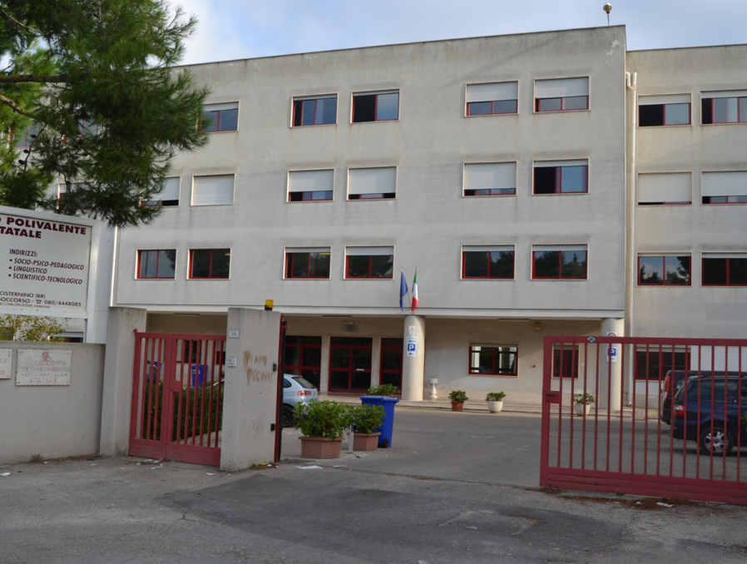
LICEO POLIVALENTE STATALE
“don Quirico PUNZI”
SOCIO PSICO PEDAGOGICO – LINGUISTICO – SCIENTIFICO TECNOLOGICO
SCIENZE UMANE – SCIENZE UMANE opzione ECONOMICO SOCIALE
SCIENTIFICO opzione SCIENZE APPLICATE
Via Madonna del Soccorso – 72014 CISTERNINO – Tel. e Fax: 080.4444150
Web: www.liceocisternino.br.it | Pec: liceocisternino@pec.it | e-mail: liceocisternino@libero.it
Distretto scolastico n° 19 | Cod.min.: BRPM04000V | Cod. Fiscale 90015830749

Slide 4
EXIT
November 2011
March 2012
May 2012
September 2012
December 2012
March 2013

Slide 5
November 2011
Welcome to our school
Our experiences
Cisternino
Traditions and typical dishes
Logo Comenius
HOME

Slide 6
March 2012
The flag
The National Anthem
Coat of arms
National day
The origins of the Italian language
Promessi Sposi
HOME

Slide 7
May 2012
Snapshots from the past
HOME

Slide 8
September 2012
Conversations
HOME

Slide 9
Cinzia Petrelli
December 2012
Clara Lomonaco
Clara Punzi
Gianfranco Lafratta
Martino Genchi
Simona Guarini
Simona Potenza
Simona Sardella
HOME

Slide 10
March 2013
Traditional Games
CATHOLICISM
HOME

