Slide 1
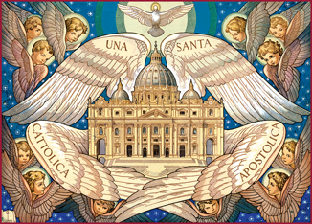
CATHOLICISM
The most popular religion in Italy

Slide 2
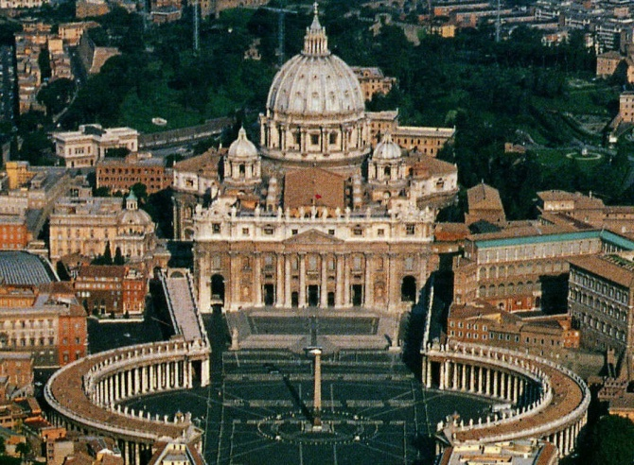
WHAT DOES“CATHOLIC” MEAN?
The term “catholic” comes from the Ancient Greek and it means “universal”. So, it indicates the only Christian Church.

Slide 3
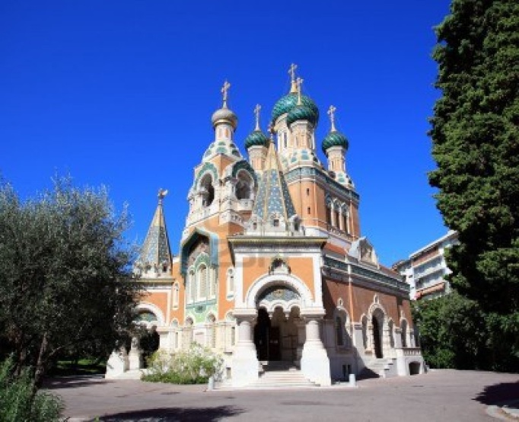
WHAT DOES“CATHOLIC” MEAN?
In 1054, during the Roman Empire, after the division of the Eastern Church from the Western Church, this term began to indicate the Church of Rome, guided by the Pope; at the same time, the eastern Church defined itself “Orthodox”.

Slide 4
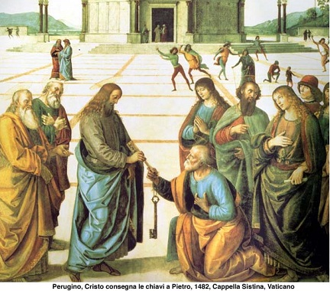
WHO FOUNDED THE CATHOLIC CHURCH?
The Catholic Religion was
founded by Jesus.
The Church is a society
and community for the
Catholics.
Jesus elected Saint Peter
as the head of the Church.
Now, the Pope is the guide of the Church
and he’s considered Peter’s successor.

Slide 5
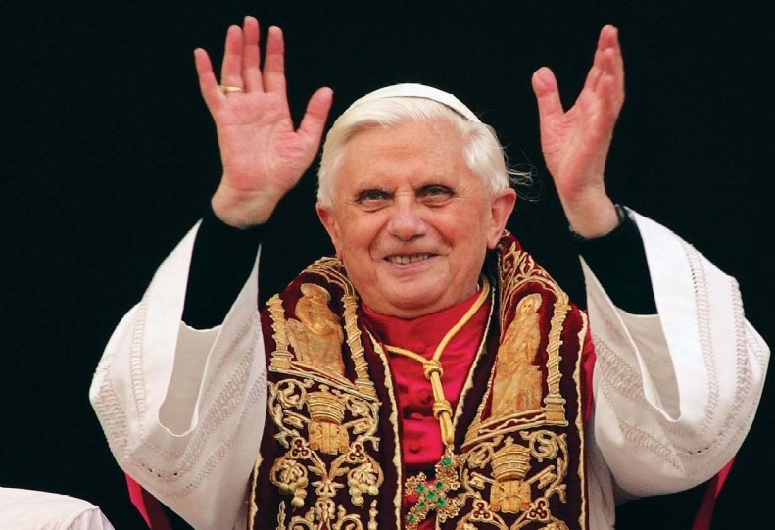
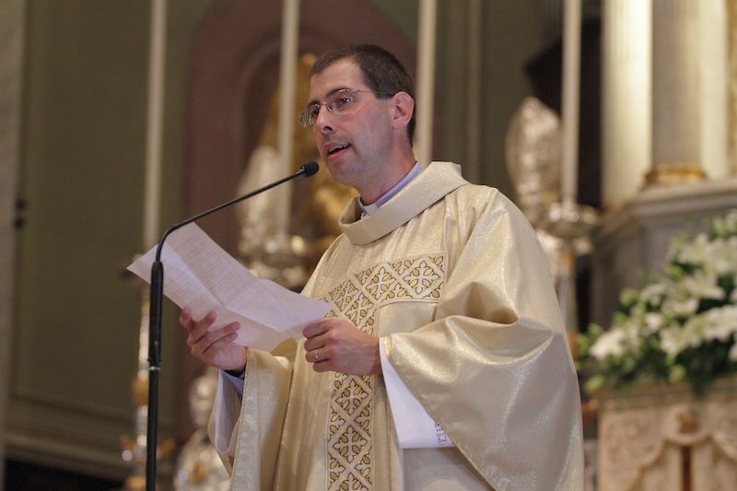
HOW IS THE CATHOLIC CHURCH ORGANISED?
TheCatholic hierarchy is led by the Pope and includes cardinals, patriarchs and diocesan bishops.
The Pope: is the guide of the Church
The Bishops: apostles’ successors, who are guides to a community,
called “diocese”
The Priests: bishop’s calloborators
and guides in little “ parish churches”

Slide 6
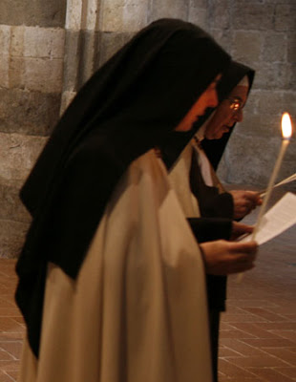
The Deacons: who take care of their community needs (like helping poor or sick people)
The Religious followers: men and women who, following Christ’s rule, renounce having a family to take care of the Church with their prayers and charity ( like monks, nuns or sisters etc.)
-The “Laical people”: common people who belong to the Church because they are baptized.

Slide 7
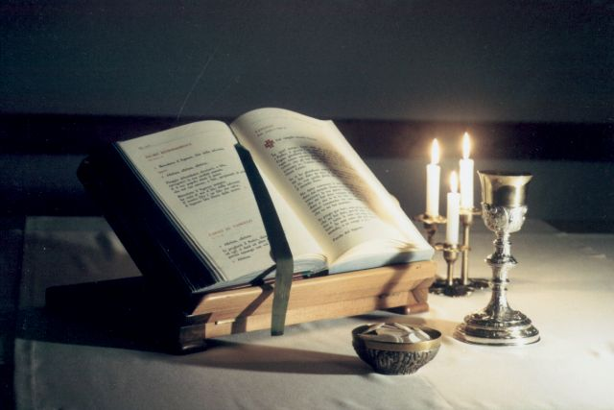
THE TASKS OF THE CHURCH
The Announcement
It is the proclamation of the Gospel message:
its teaching is
the basis of the
Bible and its interpretation
by the Church

Slide 8
THE CELEBRATION OF THE SACRAMENTS
The Sacraments are considered signs of salvation. They are seven and they represent the most important moments in the life of a christian.
Period of the life | Sacrament
Birth | Babptism
Need to be absolved | Confession
Need to live in communion with God | Holy Communion
Growth | Confirmation
Choose to become priest | Order
Choose to get married | Marriage
Need to be comforted in sickness | Last rites - Extreme unction

Slide 9
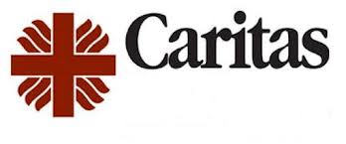
LIFE OF CHARITY
Since the beginning, the Church has had the aim of witnessing his “Love to brothers” commandment. Throughout the history the Church has realized service activities ( in hospitals, hospices, schools) that nowadays belong to the “mission world.”

Slide 10
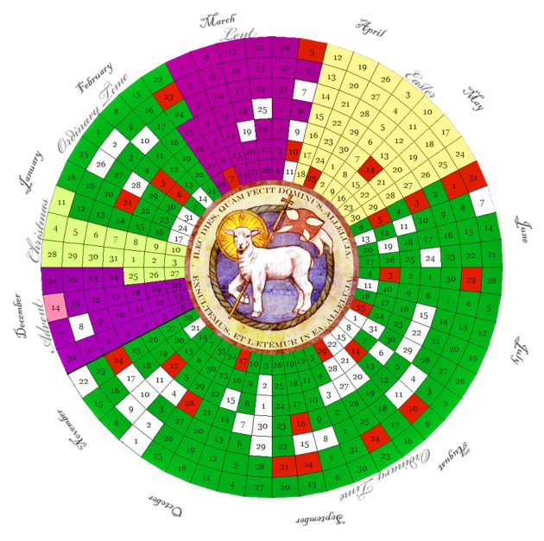
LITURGICAL CALENDAR

Slide 11
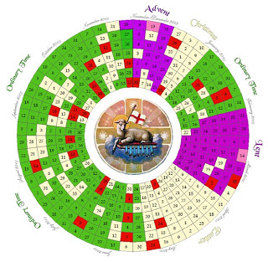
LITURGICAL CALENDAR
The Catholics’ holy day is Sunday, which means “God’s day”. Actually, the Sunday Holyday remembers, through the Holy Mass, the mistery of Jesus’s sacrifice, death and resurrection. This rite isn’t only memory, but, as it’s a sacrament, it renewes the salvation which Jesus gave us, through different moments of the liturgy ( in particular the Holy Cmmunion)

Slide 12
THE LITURGICAL YEAR
It’s the memory of the history of salvation which ends with Easter and the resurrection of Jesus.
PERIODS | MEMORIES
Advent (4 weeks before Christmas) | Waiting for Jesus’ s birth
Christmas (25.12-06.01) | Jesus’s birth and Epifany
Ordinary days (Baptism-Ash Wednsday) | Jesus’s speeches and his miracles
Lent (40 days before Easter) | Prayer and penance
Three days before Easter | Holy Thursday, Saturday and Sunday
Easter’s period (Easter-Pentecost) | Resurretion and donation of Holy Spirit
Ordinary days (Pentecost-Advent) | Holy Spirit and Church’s actions

Slide 13
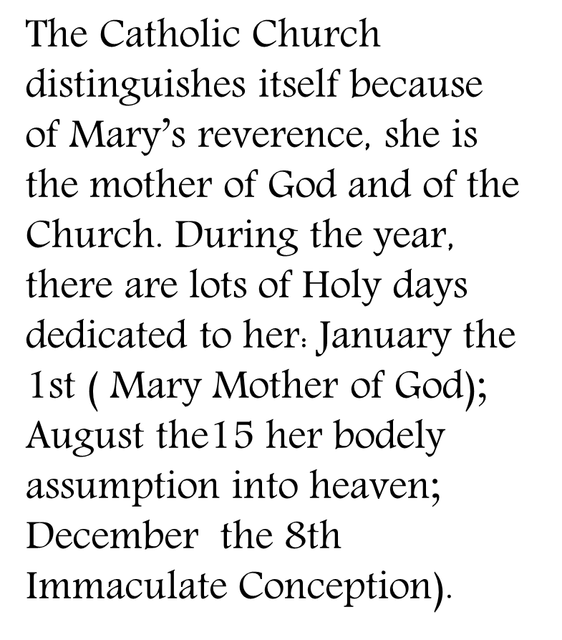
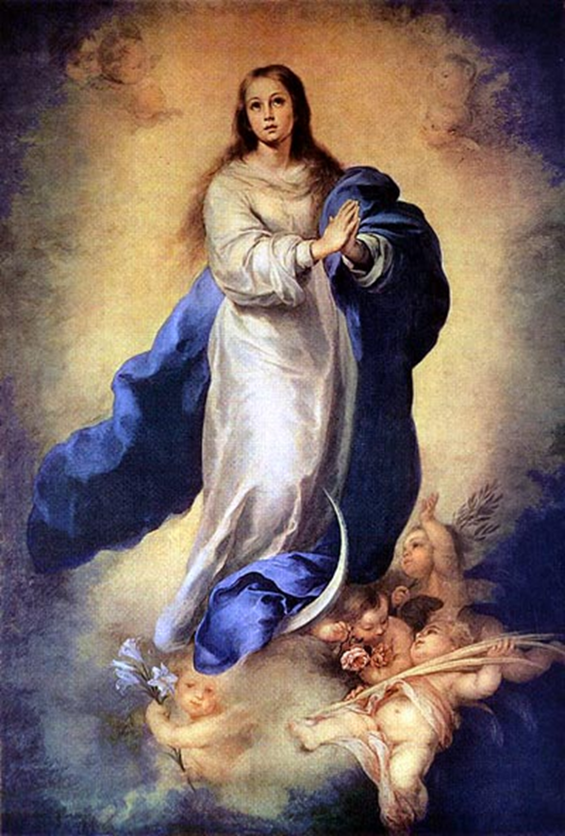

Slide 14
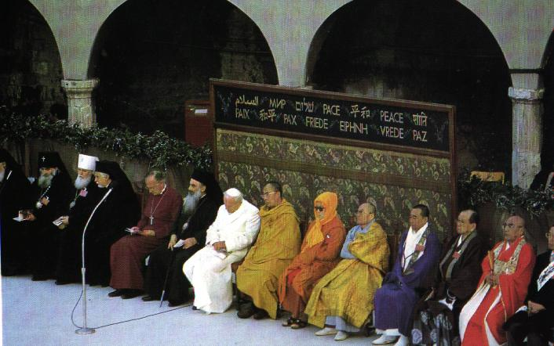
After illustrating Catholicism’s caracteristics, it’s necessary to remember that it rapresents one of different ways to live the faith in Jesus and, so, to be a christian. For this reason, Catholics and the other christian’s denominations (Orthodoxes, Protestants and Anglicans) , trying to follow Jesus’s prayer (Gv 17, 20-23), have created the Ecumenical Movement to restore the unity between all churches, through the prayer and underlining , in particular, common elements.

Slide 15
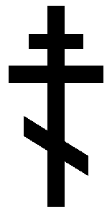
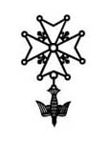
COMMON ELEMENTS OF CATHOLICS, ORTHODOXES AND PROTESANTS
The Bible (divided in Old and New Testament) is the Holy Book
The mistery of the Holy Trinity: Father, Son and Holy Spirit
Jesus Christ is God’s Son, who came on the earth to save human beeings (True God and True Man)
There’s the dead’s resurretion and the neverending life.
The man is saved by Jesus through faith.

